Slide 1
Customer Churn Prediction Using Machine Learning
By: Kedhar Swaminathan

Slide 2
The Business Problem
Customer churn = customers discontinuing their subscription
Some of the side-effects of customer churn are:
Lost recurring revenue
Higher customer-acquisition costs
Missed retention opportunities

Slide 3
Can We Predict Customer Churn?
Can customer demographic, account, service, and billing information be used to predict which customers are most likely to churn?
We can also use this questions to answer several other secondary questions:
Which customer characteristics are associated with churn?
Which machine-learning model performs best?
Which features are most useful for predicting churn?
How could predictions support retention?

Slide 4
Telco Customer Churn Dataset
The dataset contains 7043 customers, 21 variables, and 26.5% of the customers’ churn
Customer Information | Examples
Demographics | Gender, Senior Citizen, Dependents
Account | Tenure, Contract
Services | Internet, Security, Tech Support
Billing | Monthly Charges, Total Charges
Target | Churn

Slide 5
Before Modeling: Is the Data Trustworthy?
The initial dataset: 7,043 rows × 21 columns
Data quality checks:
Missing values
Incorrect data types
Duplicate records
Unique categories
Unique categories
Target variables
One important issue involved TotalCharges. Although the initial null check did not identify missing values, further inspection showed that some observations contained blank strings rather than actual missing-value markers

Slide 6
Understanding Who Churns
To understand customer churn and why it happens we investigated several variables such as churn distribution, contract type, tenure, monthly charges, total charges, etc.…
And I looked at both numerical and categorical variables. For numerical variables, I examined distributions and relationships with churn. For categorical variables, I compared churn across groups.
I also used correlation analysis and statistical tests to determine whether some of the relationships I observed were statistically significant.

Slide 7
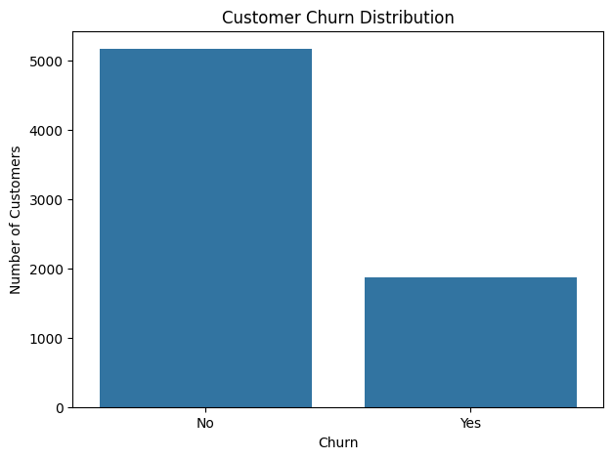
Customer Churn Distribution
The notebook reports 5,174 customers who did not churn and 1,869 who did
In other words, roughly one out of every four customers left
This also creates an important modeling consideration: the target is imbalanced. There are substantially more customers who remain than customers who churn

Slide 8
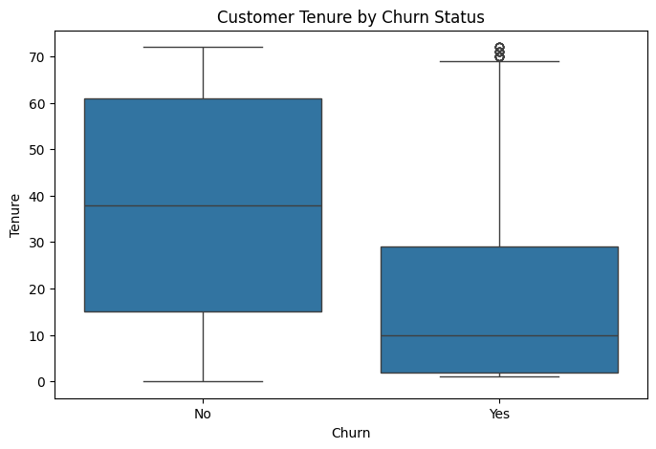
Customer Tenure Is Associated With Churn
Customers who churn generally have shorter tenures
This was particularly interesting from a business perspective because it suggests that the early portion of the customer lifecycle may represent an important retention opportunity

Slide 9
Turning Customer Data Into Model Inputs
Our graphic pipeline went from raw customer data to clean data to removing identifiers to converting variables to encoding categorical features to standardizing numerical and finally to splitting the dataset into train and test sets
Feature engineering is the process of transforming raw data into variables that are suitable and useful for machine learning
Standardization puts numerical features on a comparable scale. This is particularly relevant for models such as Logistic Regression where feature scale can influence the optimization process

Slide 10
Which Features Deserve Attention?
Numerical analysis
Tenure
Monthly Charges
Total Charges
Average Monthly Spend
Categorical analysis
Contract
Internet Service
Payment Method
Tech Support
Online Security
Statistical significance helped me understand relationships; it was not the only criterion for determining predictive usefulness

Slide 11
How Did I Make Sure the Model Was Actually Being Tested?
One of the most important steps in predictive modeling is making sure the model is evaluated on data it did not use during training
The training set is where the algorithm learns relationships between the features and churn
The test set is held out until evaluation so that I can estimate how well the model generalizes to customers it hasn't previously seen
This helps reduce the risk of reporting a model that performs well simply because it memorized the training data

Slide 12
Why Test Multiple Algorithms?
Rather than if one algorithm would work best, I evaluated three different approaches:
Logistic Regression provided an interpretable baseline
Random Forest allowed me to model nonlinear relationships using an ensemble of decision trees
Gradient Boosting provided another tree-based approach that builds models sequentially, with each new model attempting to improve on previous errors

Slide 13
Building the Models
I also had to specify model parameters before training. For example, Logistic Regression used a maximum iteration setting of 1,000, while the Random Forest used 200 trees.
Our current modeling code includes parameters such as:
Logistic Regression
max_iter = 1000
Random Forest
n_estimators = 200
random_state = 42
Gradient Boosting
random_state = 42

Slide 14
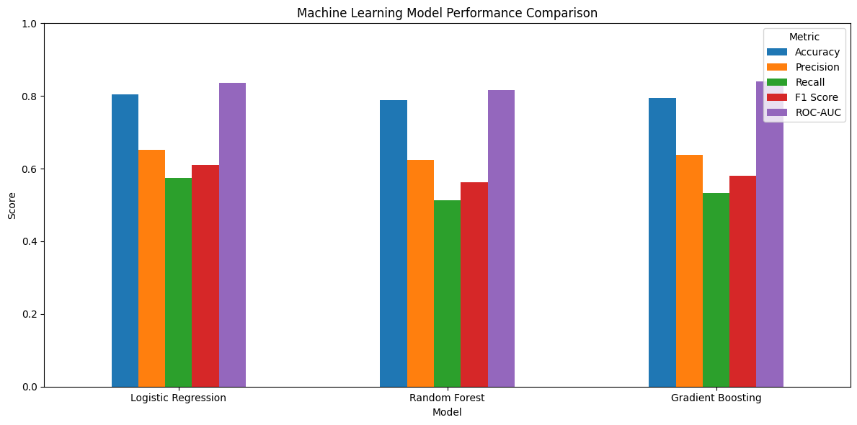
Which Model Performed Best?
This is an important result because it demonstrates that the most complex model isn't necessarily the best model for every dataset
In this case, the simpler and more interpretable Logistic Regression model produced the strongest overall performance

Slide 15
What Do Those Numbers Actually Mean?
Accuracy: 80.4%
Approximately 80% of test customers were classified correctly
Precision: 64.9%
When the model predicted churn, about 65% actually churned
Recall: 57.0%
The model identified about 57% of customers who actually churned
F1: 60.7%
Balances precision and recall
ROC-AUC: 0. 836
Measures the model's ability to distinguish churners from non-churners across classification thresholds

Slide 16
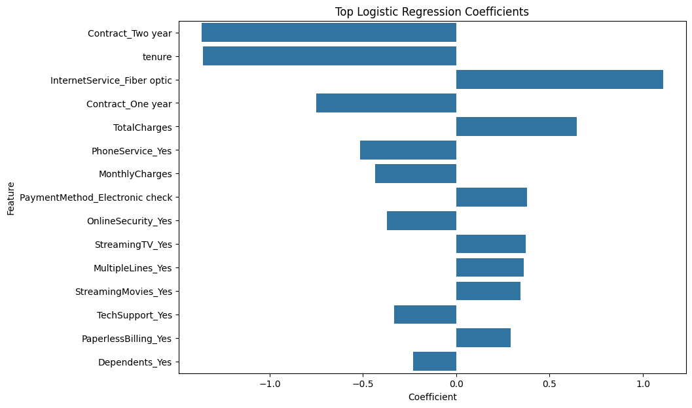
What Is Driving the Predictions?
TotalCharges, tenure, AverageMonthlySpend, and MonthlyCharges were among the strongest predictors, followed by variables such as payment method, internet service, contract type, online security, and technical support

Slide 17
How Would a Business Actually Use This?
In a real business environment, the model could be integrated with the customer database to generate a churn-risk score for each customer.
Those scores could then be surfaced through a dashboard and used by a retention team to prioritize outreach.
Instead of contacting every customer with the same campaign, the business could focus resources on customers who have a higher predicted probability of leaving.

Slide 18
Three Recommendations for the Business
Focus on Early-Customer Retention
Customers with shorter tenure showed stronger associations with churn. Create proactive onboarding and early-lifecycle engagement programs
Prioritize High-Risk Customers
Use model predictions to focus retention resources on customers with higher predicted churn risk
Investigate Pricing & Service Value
Billing and service characteristics were important predictors. Investigate whether particular pricing/service combinations are associated with increased churn

Slide 19
What Did We Learn?
To summarize, this project showed that customer churn represents a meaningful problem in the dataset, with approximately 26.5% of customers leaving
Exploratory analysis showed that tenure and several account, service, and billing characteristics are associated with churn
Most importantly, the model provides a potential way for a business to move from reacting to churn after it happens toward proactively identifying customers who may be at risk

Slide 20
Questions?

